Slide 1
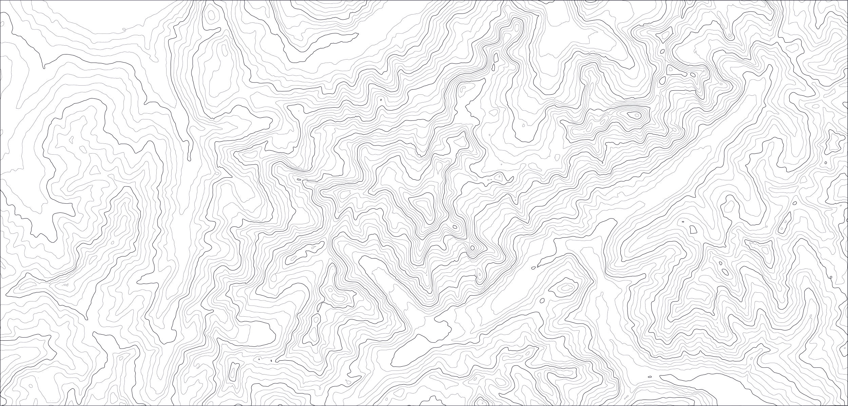

Talan - Individual diagnostic results Lead like a Guide - june 2023

Slide 2
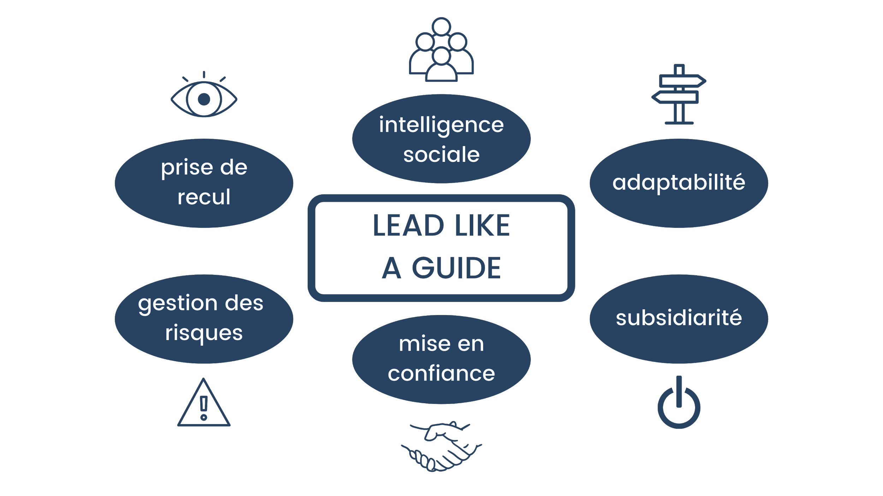
Lead like a Guide
Christopher Maxwell’s model
Dr Chris Maxwell is a Leadership professor at the Wharton School (University of Pennsylvania) and wrote the book “Lead Like a Guide”
socially intelligent
big-picture thinker
adaptable
manage risk
empower others
develop trust
develop trust

Slide 3
Individual diagnostic results
The model, re-adapted
From our own experience and studies, here is what we have updated from Dr. Chris Maxwell’s model
Addition of decision making
Addition of self-awareness
Adaptability was reworded to include learning
Develop trust and empower others were grouped into driving action”
Adaptability
Learning ability
Self consciousness
Risk management
Big picture thinking
LEAD LIKE A GUIDE
Decision making
Social intelligence
Develop trust
Empower others
Driving action

Slide 4
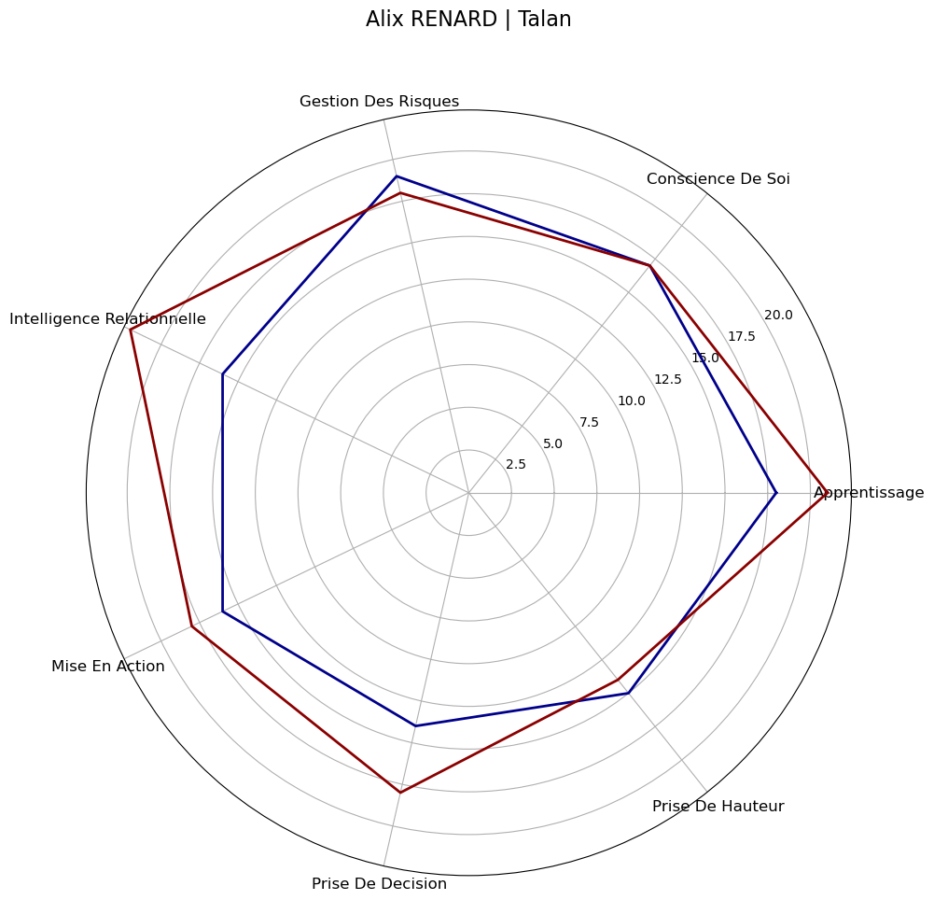
Individual diagnostic results
For someone who left the company
Company’s participants average results
Your own results

Slide 5
“How you climb a mountain is more important than reaching the top.”
Yvon Chouinard
Questions ? adrien@mountain-path.com +33 6 01 07 32 58 +44 7944 403 872

